Slide 1





WP1- PROJECT MANAGEMENT

Slide 2
WP2- Strengthening VET Teacher Competencies for FLIGHT

Slide 3
2.1 | Kickoff Meeting - Detailed planning of the WP | DONE
2.2 | Requisites of FLIGHT KIT | DONE
2.3 | Developement of FLIGHT KIT | DONE
2.4 | Creation and aquisition of the FLIGHT KIT to be used on the face-to-face training | DONE
2.5 | Foundation Training Primer: Navigating Drone Technology | DONE
2.6 | MultiSector Takeoff: Navigating Drone Tech in VET Across Agriculture, Construction, Disaster Response, and Environmental Protection | DONE
2.7 | Handbook for FLIGHT KIT and translations | ON GOING
2.8 | FLIGHT Training - Local Replication WK | MISSING
2.9 | WP evaluation | MISSING

Slide 4
2.7- Handbook for FLIGHT KIT and translations
STATUS
ALMOST DONE - English version
DEADLINE TO BE COMPLETED: TO BE DEFINED (END OF JANUARY)
DIMEM – will put all together and formated - TO BE DEFINED (MID OF FEBRUARY)
MISSING – Translations (TR, PT, MK, SK, IT)
DEADLINE – 15 MARCH

Slide 5
2.8- FLIGHT Training - Local Replication WK
STATUS
- Each partner should organize 1 event (at least) following the strategy defined
- At least 200 participants
-Each event must haveProgram, Presentations, Evaluation,Attendance list, certificates
DEADLINE– TO BE DEFINED (FERBRUARY-MARCH)

Slide 6
2.9- WP evaluation
STATUS
- To be done online (march/april)

Slide 7
WP3- FLIGHT Resource Center

Slide 8
FLIGHT Resource Center - WP
OBJECTIVES
-Design, develop and deliver a FLIGHT RESOURCE CENTER that provides high-quality resources and support to VET teachers and students on drone technology in the areas of agriculture, construction, disaster response, and environmental protection.
-Create a FLIGHT RESOURCE CENTER that is user-friendly, engaging, and accessible to VET teachers and students from all backgrounds.
-Promote the FLIGHT RESOURCE CENTER to empower VET teachers and students by highlighting the significance and benefits of drone technology education.

Slide 9
FLIGHT Resource Center - WP
RESULTS
1. Guidelines to create projects for FLIGHT RESOURCE CENTER (including the Template of FLIGHT RESOURCE CENTER projects) - (TR, PT, MK, SK, IT, EN)
2. FLIGHT RESOURCE CENTER digital plataform
3. 70 projects developed by the partnership (TR, PT, MK, SK, IT, EN)
4. Flight Best Practices, with 40 pages (TR, PT, MK, SK, IT, EN)
5. Promoting events of FLIGHT RESOURCE CENTER
6. WP evaluation

Slide 10
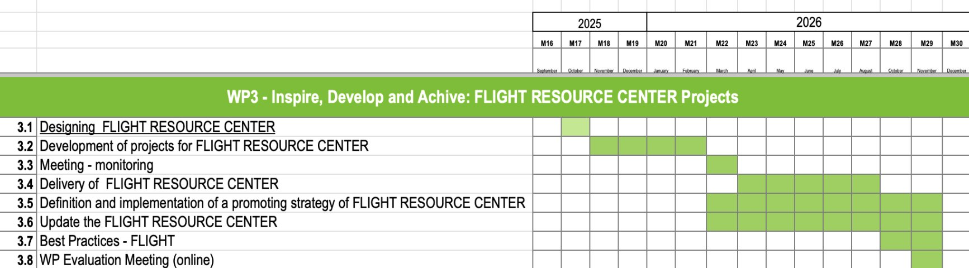
FLIGHT Resource Center - WP
GANTT

Slide 11
1. Guidelines to create projects for
FLIGHT RESOURCE CENTER
STATUS
DONE - English version
MISSING – Translations (TR, PT, MK, SK, IT)
DEADLINE – 16 February

Slide 12
2. FLIGHT RESOURCE CENTER
DIGITAL PLATAFORM
STATUS
DONE

Slide 13
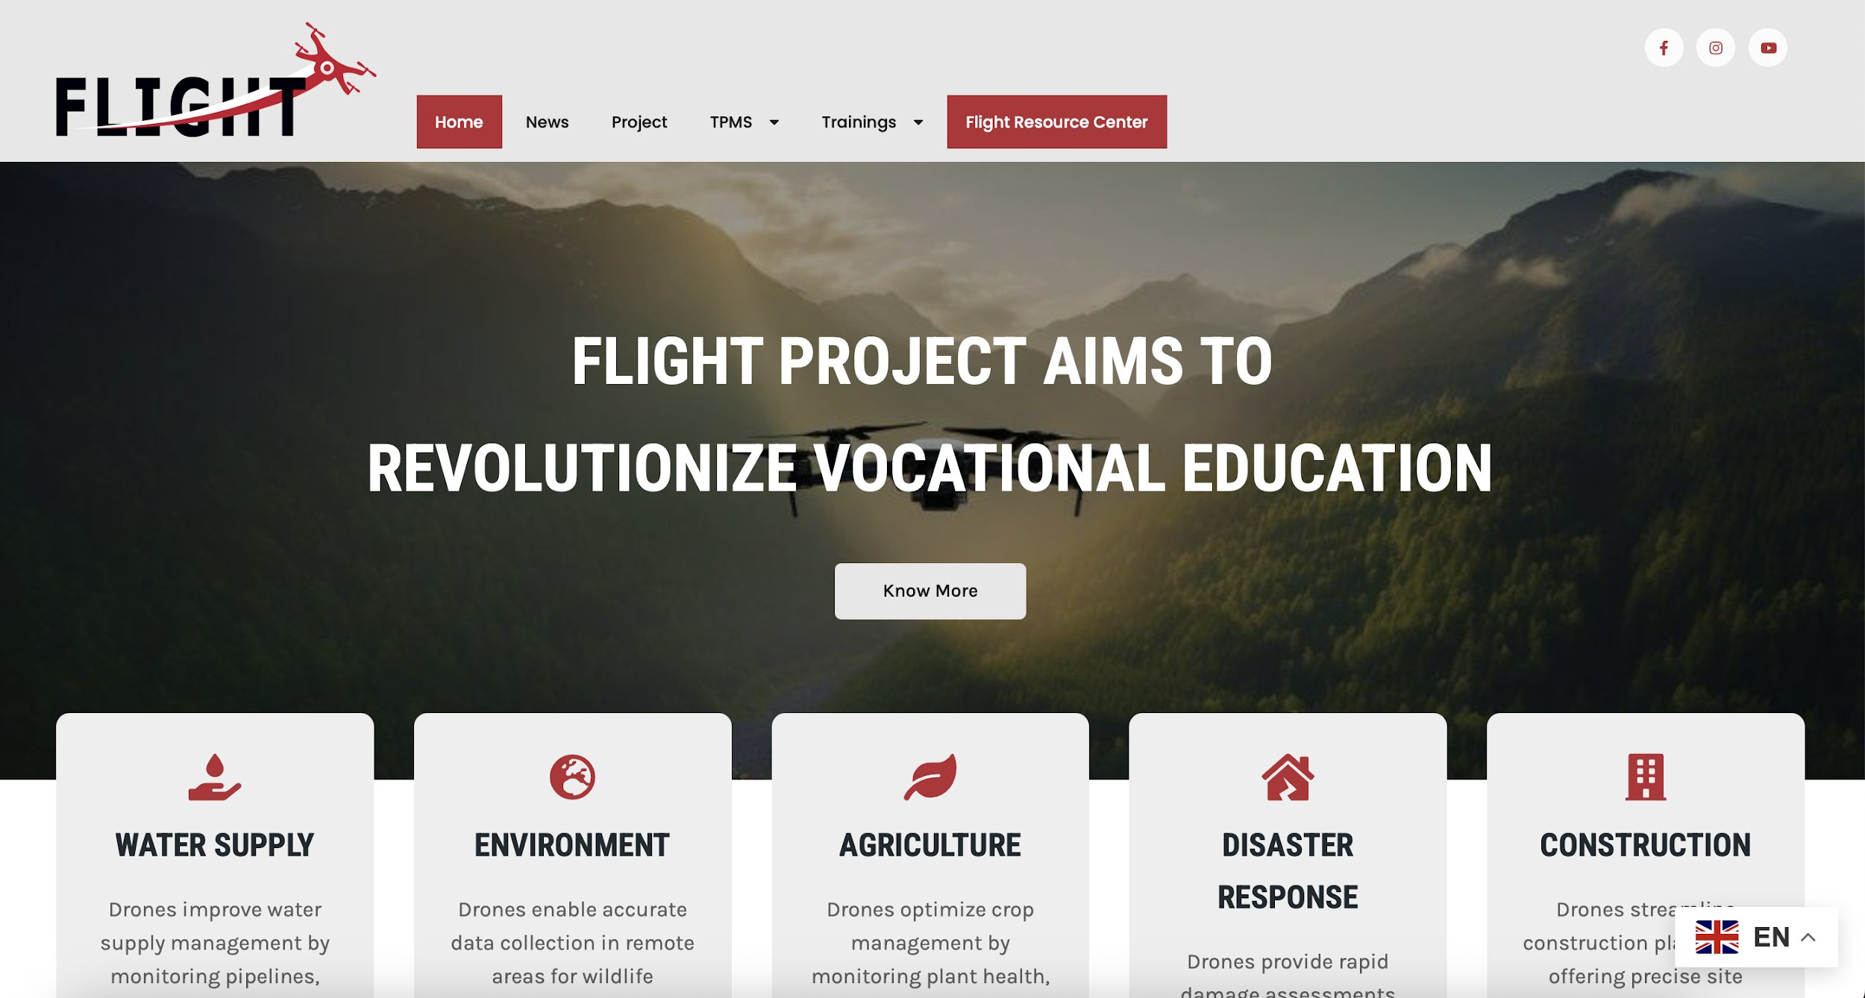
2. FLIGHT Resource Center

Slide 14
2. FLIGHT Resource Center

Slide 15
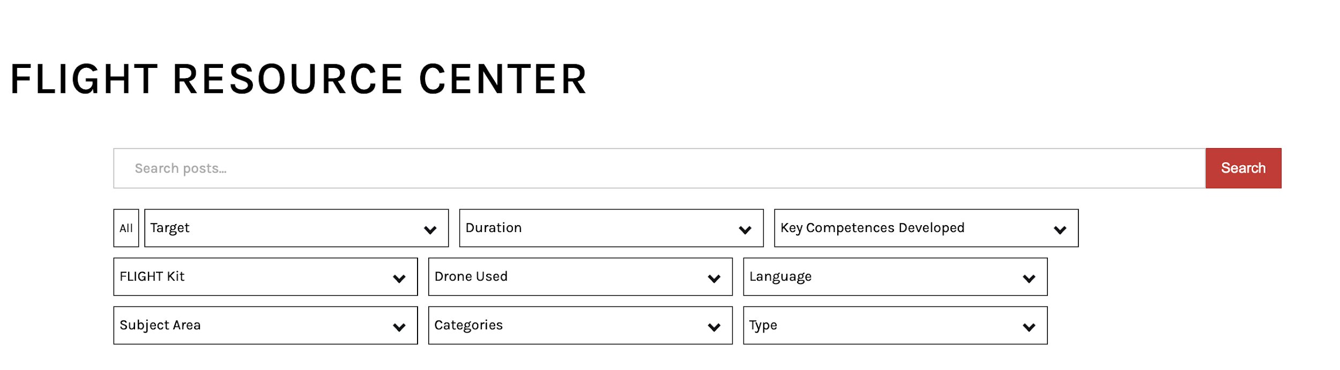
FLIGHT Resource Center

Slide 16
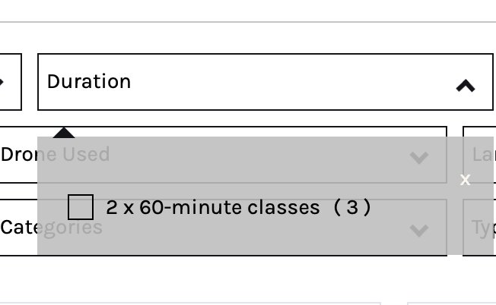
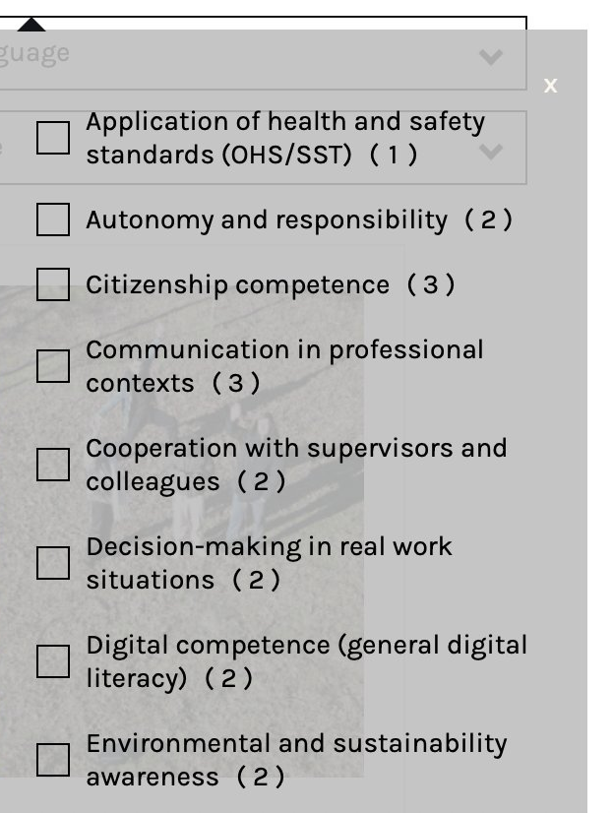
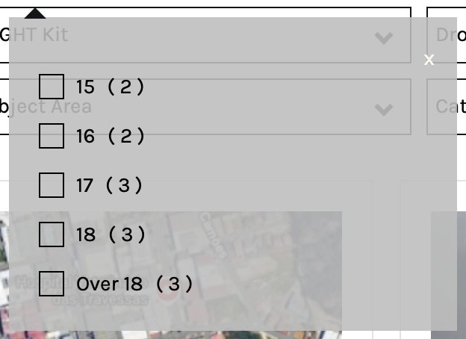
FLIGHT Resource Center

Slide 17
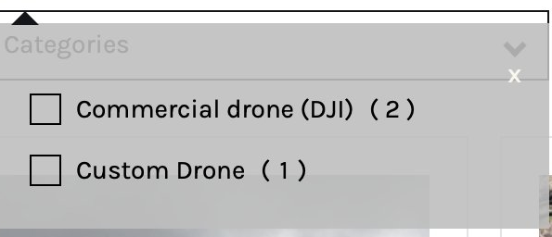
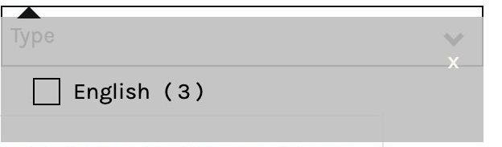
FLIGHT Resource Center

Slide 18
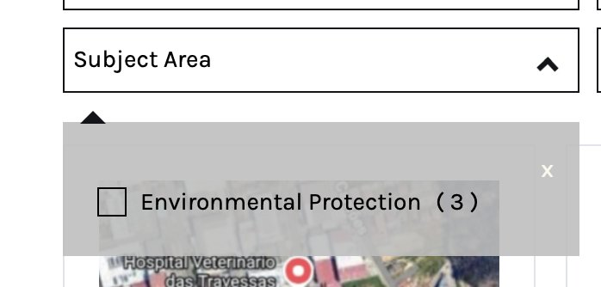
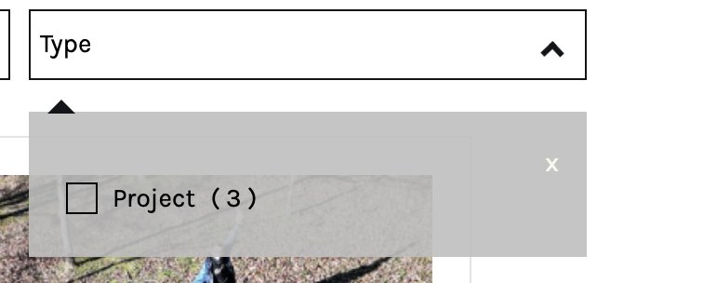

Slide 19
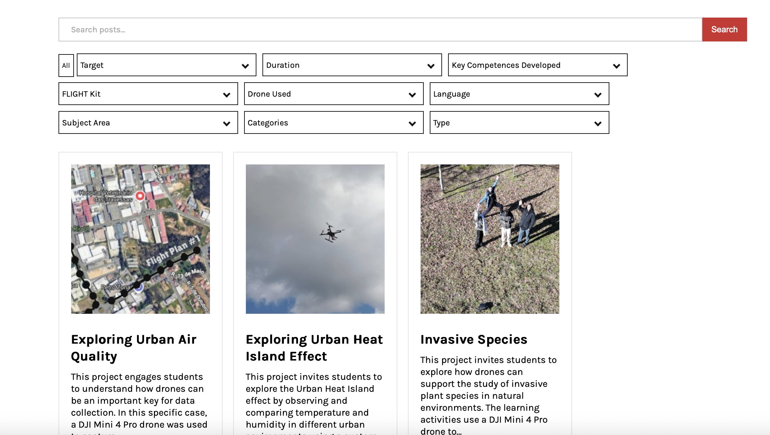
FLIGHT Resource Center

Slide 20
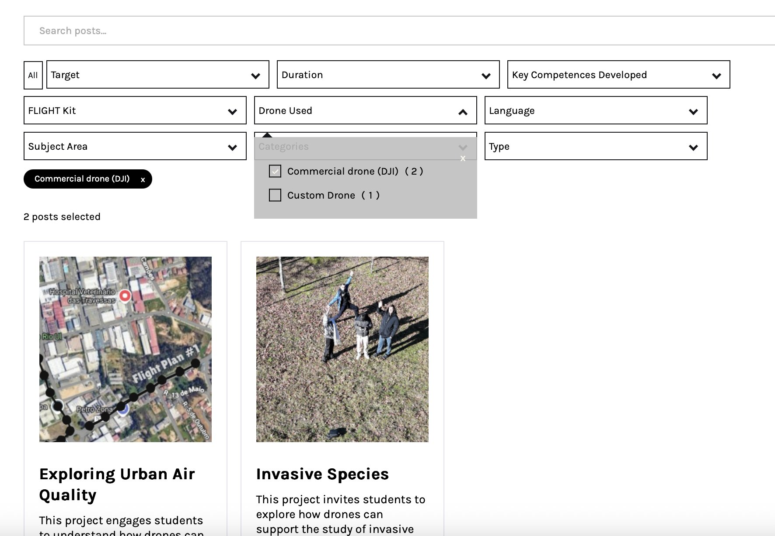
FLIGHT Resource Center
Using filters

Slide 21
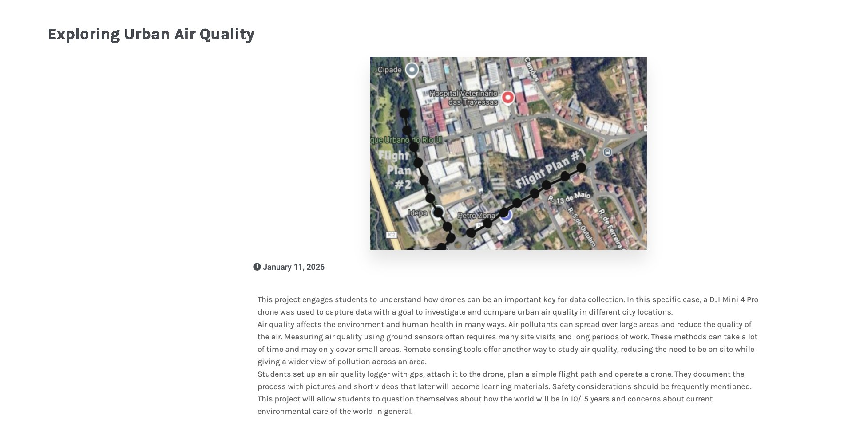
FLIGHT Resource Center
Exploring a project/lesson plan
TITLE
TITLE
IMAGE
SHORT DESCRIPTION

Slide 22
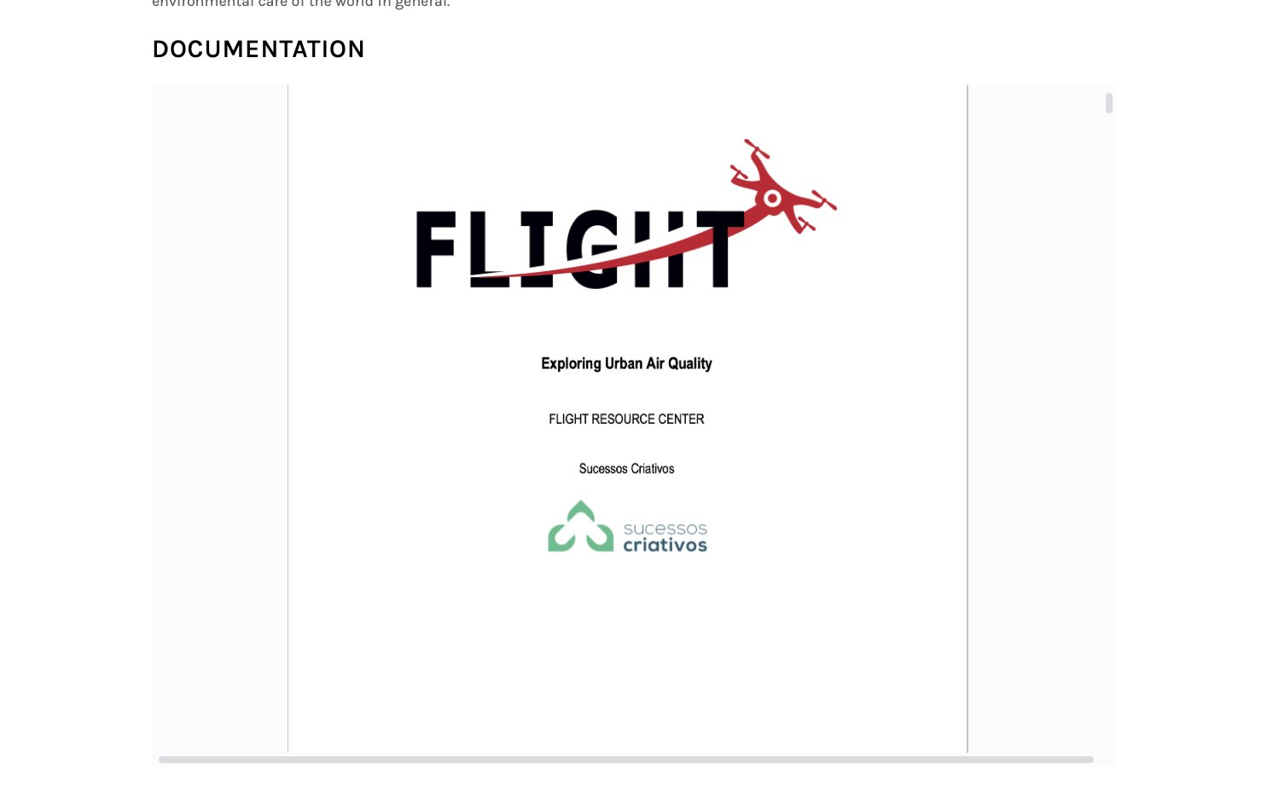
FLIGHT Resource Center
LESSON PLAN / PROJECT
(AS IN THE TEMPLATE)

Slide 23
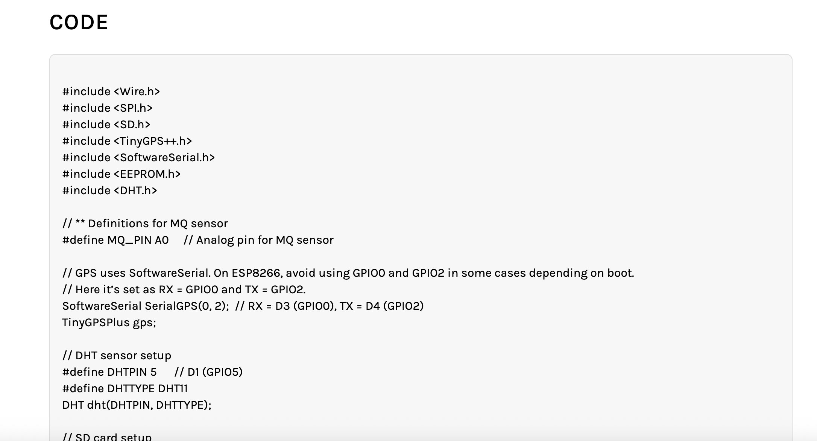
FLIGHT Resource Center
CODE SECTION
(If existist)

Slide 24
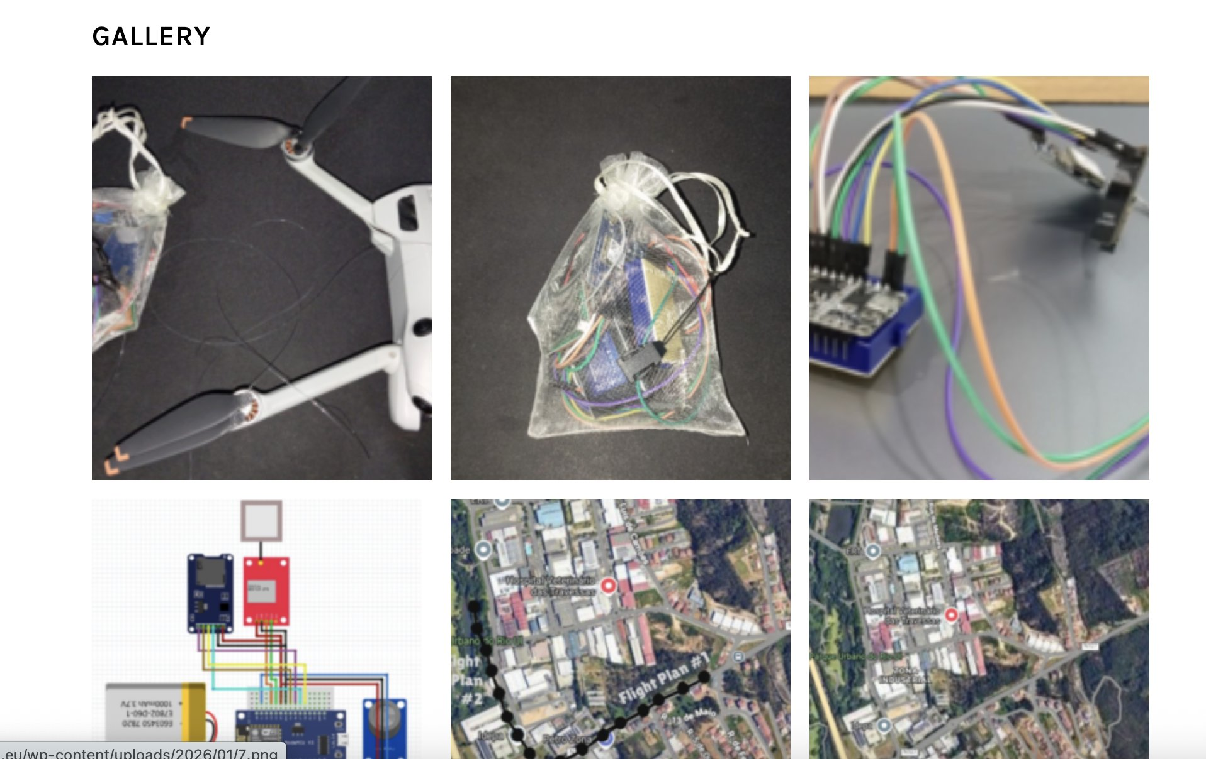
FLIGHT Resource Center
IMAGES / VIDEOS RELEVANT TO THE PROJECT/LESSON PLAN

Slide 25
3. Development of the 70 projects
STATUS
DONE - 14 (?) English version
MISSING 56 PROJECTS!! – Translations (TR, PT, MK, SK, IT)
DEADLINE TO COMPLETE THE PROJECTS– TO BE DEFINED (END OF MARCH)
DEADLINE TO TRANSLATE THE PROJECTS– TO BE DEFINED (END OF APRIL)

Slide 26
4. Definition and implementation of a promoting strategy of FLIGHT + RESOURCE CENTER
MISSING
SUCESSOS AND DIMEM WILL DRAFT – TO BE APPROVED (END OF MARCH)

Slide 27
5. Promoting events of FLIGHT RESOURCE CENTER
STATUS
- Each partner should organize 1 event (at least) following the strategy defined
- At least 200 participants
DEADLINE– TO BE DEFINED (May-October)

Slide 28
6. Flight Best Practices
- Flight Best Practices, with 70 pages (10 per partner)
- Each partner will select and apply (if possible) 2 projects and do the evaluation
- SUCESSOS CRIATIVOS will create the structure
- The document should be translated (TR, PT, MK, SK, IT, EN)
DEADLINE TO THE EN VERSION TO BE DEFINED (END OF SEPTEMBER)
DEADLINE TO TRANSLATIONS TO BE DEFINED (END OF OCTOBER)

Slide 29
WP4- FLIGHT Communication, Dissemination and Exploitation
GTU (TK) will led

Slide 30







THANK'S FOR
YOUR ATTENTION

