Slide 1





Turning Flight Data into Insight
Data Visualization

Slide 2
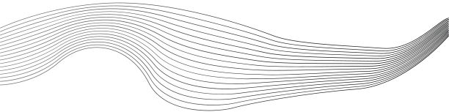
CONTENT
01
Clean Your Data
02
Kepler
03
Google My Maps
Notes:
The objective of this section is to integrate multiple sensing and logging components into a unified drone-based system capable of collecting and storing environmental and geolocation data. Using the NodeMCU (ESP8266), you will combine the NEO-6M GPS module, the BME680 environmental sensor, and the microSD card module to build a functional custom data logger. This setup will record real-time temperature, humidity, pressure, gas, and location information into a .csv file that can be easily opened and analyzed. The goal is to demonstrate how a simple, low-cost embedded system can support advanced environmental monitoring tasks when applied in the right context.

Slide 3



Clean Your Data
Before using Kepler.gl or google maps, it's essential to clean your log.csv to remove:
Rows with "Invalid" in Latitude or Longitude
Duplicated headers
How to Clean:
1-Open log.csv in Excel, Google Sheets, or a text editor.
2-Use CTRL + F (or ⌘ + F) to search for "Invalid" and duplicated header information like “Date,Time,Latitude,Longitude,Temperature(C),Humidity(%),Pressure(hPa),Gas(kOhms),Altitude(m)”— delete any rows that contain it.
3-Save the cleaned version as log_clean.csv.

Slide 4
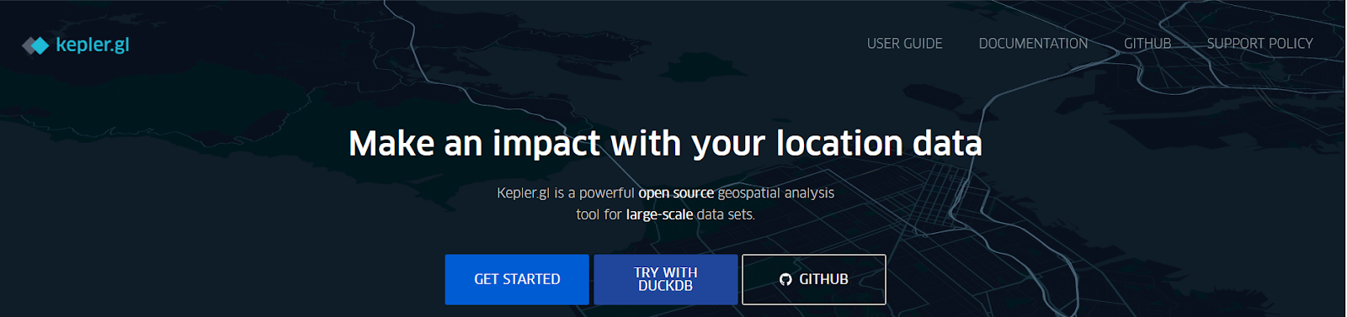
Kepler
Go to https://kepler.gl/
Click “Get Started”

Slide 5
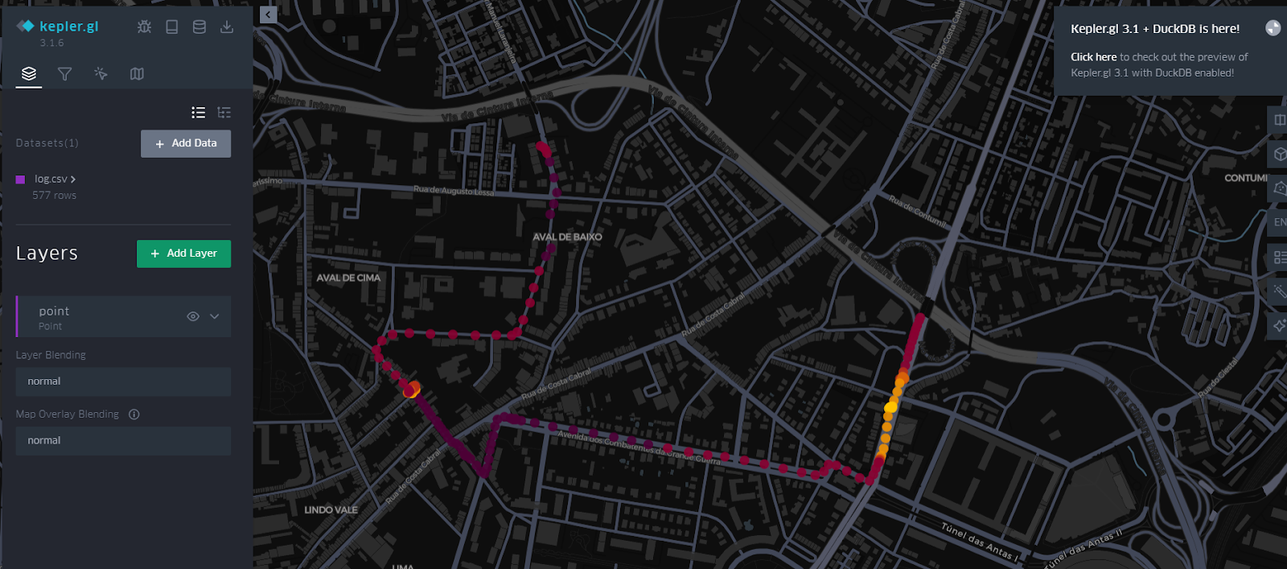
Kepler
Upload your file to the “Add Data To Map”
Kepler will process the file and automatically detect your location fields.

Slide 6
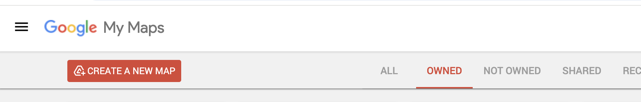
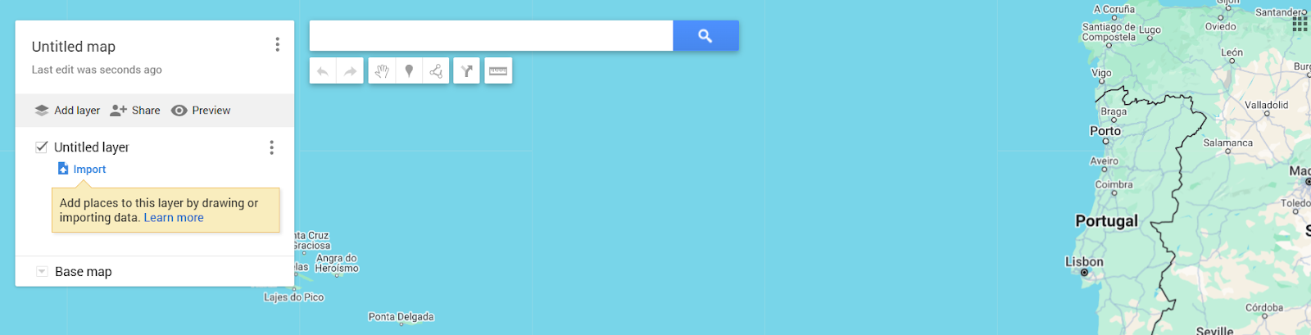
Google My Maps
Open Google My Maps
Go to https://www.google.com/mymaps using any browser. Make sure you are signed in to your Google account.
Create a New Map
Click on the button labeled "Create a New Map". A blank map will open, ready for customization.

Slide 7
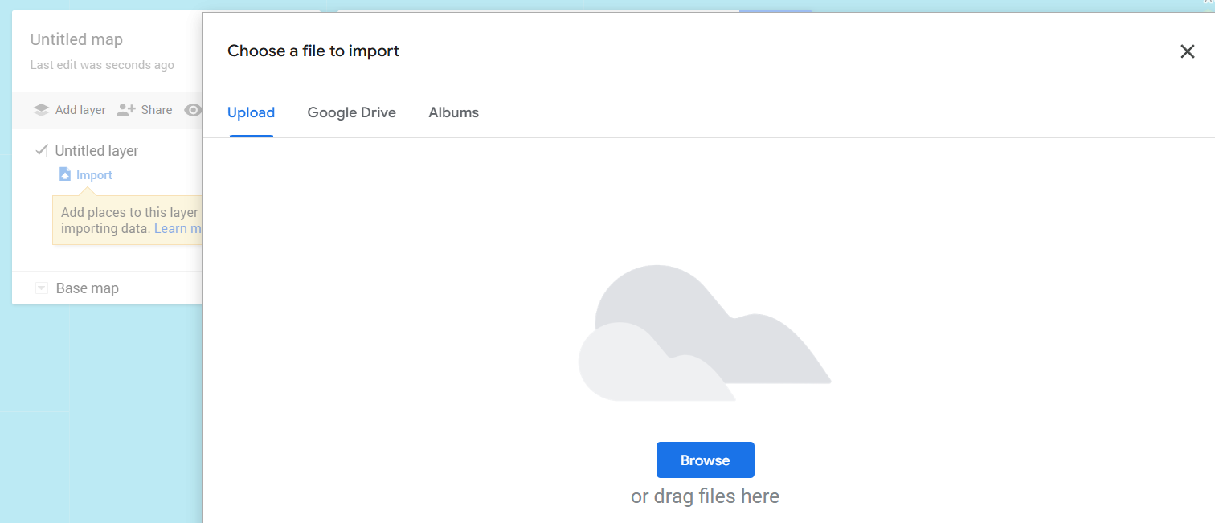
Google My Maps
Import Your CSV File
In the left panel under "Untitled Layer", click “Import”. This allows you to upload data from your computer.
Upload the Cleaned File

Slide 8
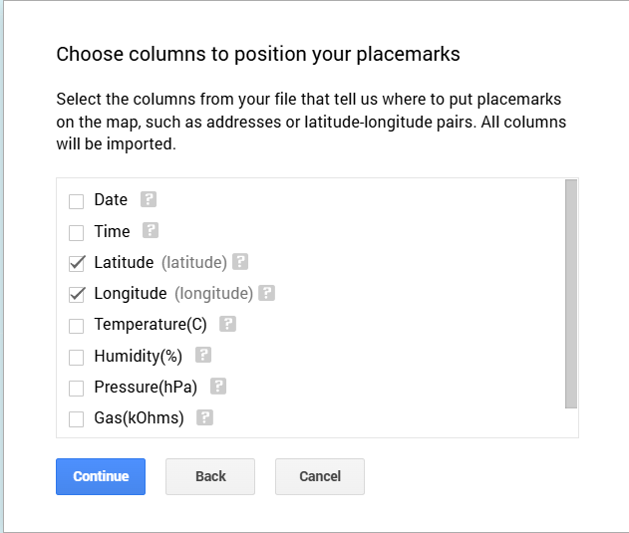
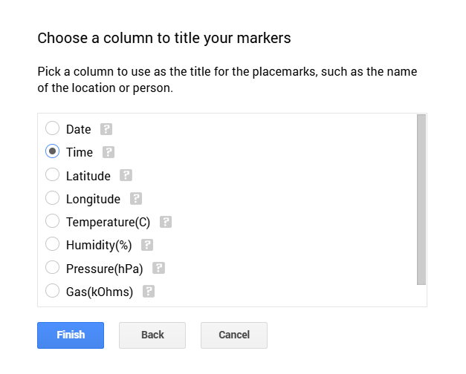
Google My Maps

Slide 9
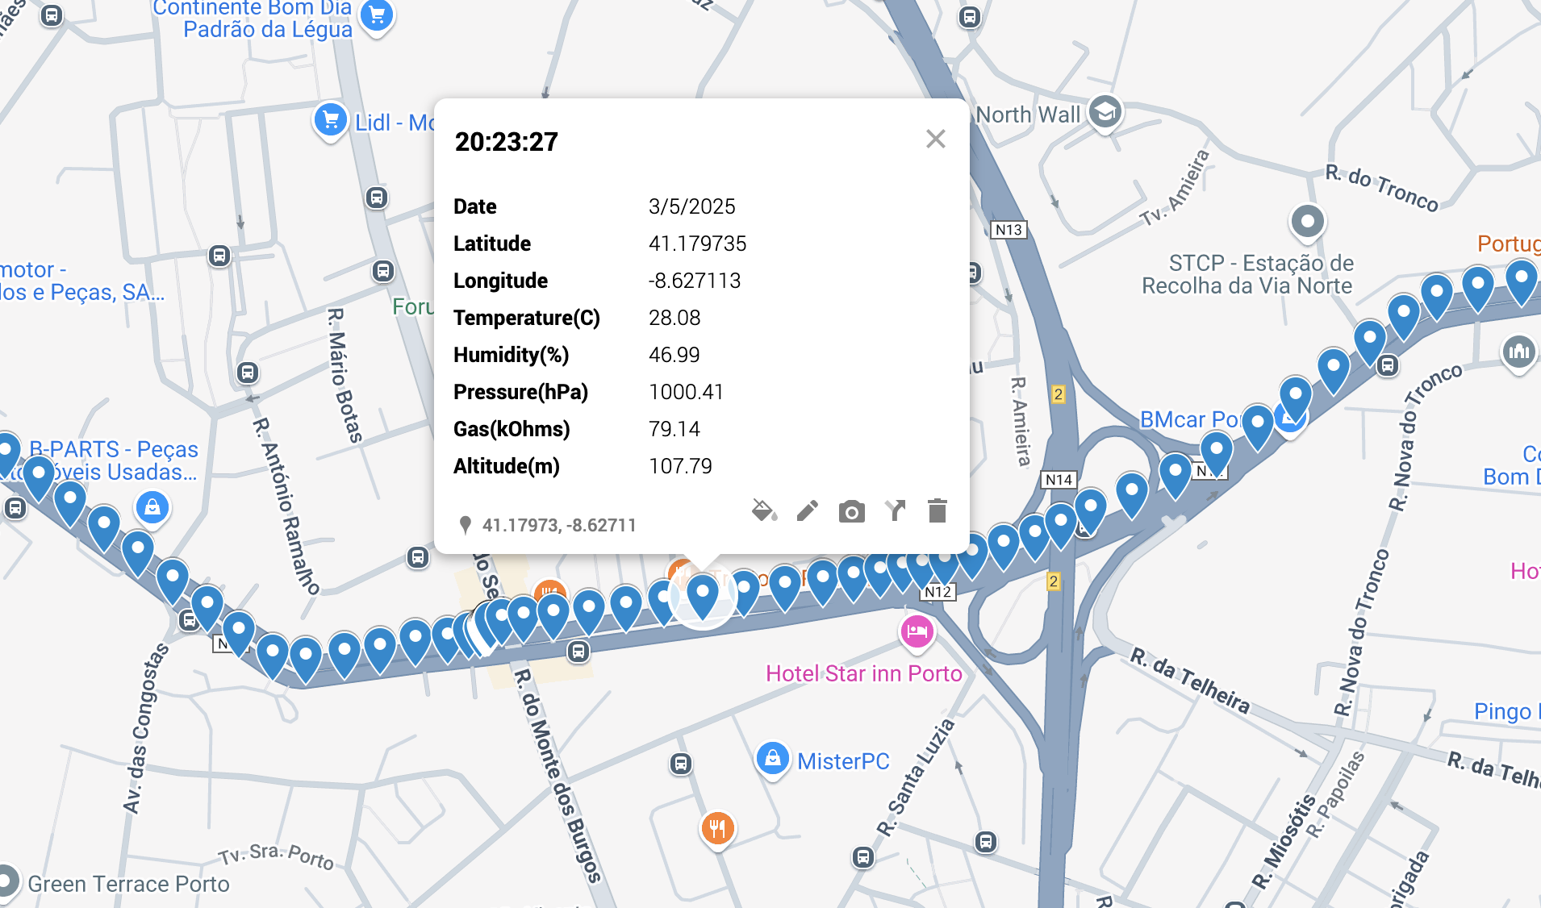
Google My Maps

Slide 10







Hands On
Your mission:
Follow this presentation and the handbook (https://docs.google.com/document/d/19S4BqSk_Rdi75qzwWkpkeVnbttc9otIEB-O9kfYv9Ww/edit?usp=sharing) as your guide.
Follow this steps and visualize your data !!

Slide 11

THANK'S FOR
YOUR ATTENTION

