Slide 1




Build It. Fly It. Log Everything.
Building a Custom Drone Logger - full integration
Notes:
Welcome! In this project, we’ll build a custom logger for a drone — the goal is full integration of sensors, storage, and real-time measurement.
You'll not only build and fly your drone, but also log everything that happens during flight — from environmental data to geolocation.

Slide 2



Goal
Objective:
To integrate multiple sensing and logging components into a unified, drone-based system that collects and stores environmental and geolocation data.
What You'll Use:
NodeMCU (ESP8266) – the system’s microcontroller
NEO-6M GPS module – provides real-time location and time
BME680 sensor – captures temperature, humidity, pressure, and gas (VOCs)
microSD module – logs data into a structured .csv file
Demonstrate how a simple, low-cost embedded system can support real-world environmental monitoring across sectors like agriculture, urban planning, and disaster response.

Slide 3
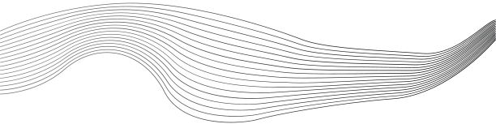
CONTENT
01
Wiring
02
Prepare the microSD Card
03
Example Code
Notes:
Here’s our mission plan:
Wiring – connecting the sensors, microcontroller, GPS, and microSD properly.
Prepare the microSD Card – to ensure data can be saved reliably.
Example Code – which combines everything: GPS, sensors, and SD logging into a single system.

Slide 4
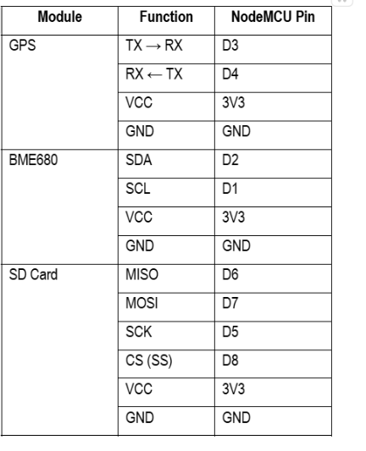
Wiring
Notes:
Wiring is crucial here because we’re integrating multiple modules:
A BME680 for environmental readings
A GPS module for geolocation
A microSD module for offline storage
You’ll likely use pins D1/D2 for I2C (sensor), D7/D8 for GPS (UART via SoftwareSerial), and SPI pins (D5–D8) for the SD card.
Since we’re using multiple protocols (I2C, UART, SPI), it’s important to avoid pin conflicts and ensure enough power — especially for the SD module which can be power-hungry.

Slide 5
Prepare the microSD Card
Before inserting the microSD into your SD module:
Format it to FAT32 (not exFAT).
  On Windows: Right-click → Format → Select FAT32.
  On macOS: Use Disk Utility → Erase → MS-DOS (FAT).
Use 32GB or smaller cards (larger cards may not work).
Insert the card into the SD module and power the system.
The SD library will automatically create the file if it doesn’t exist.

Slide 6
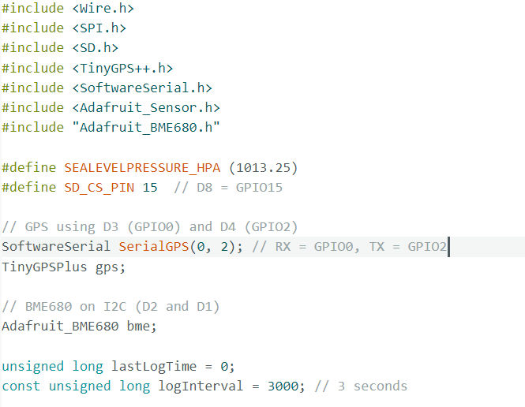
Example Code
Notes:
First, we include the libraries for GPS (TinyGPSPlus), SD card, sensor (Adafruit_BME680), and define connections using SoftwareSerial for GPS and Wire for I2C sensors.

Slide 7
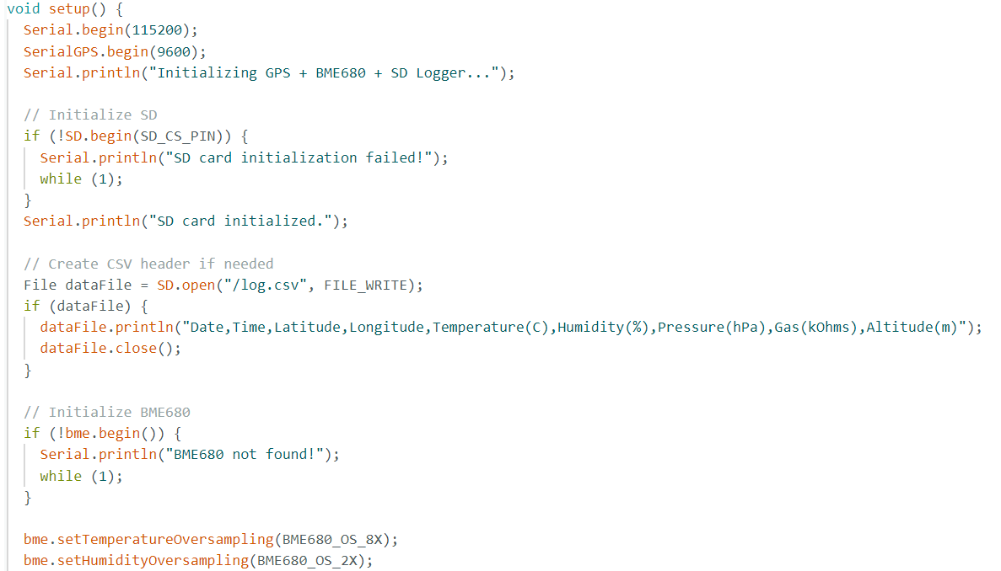
Example Code
Notes:
In setup(), we initialize:
Serial communication — both for the computer and for GPS.
The sensor — checking if it’s detected.
The microSD card — making sure it's mounted correctly.
Then we create a file on the SD card, where we will start logging data.

Slide 8
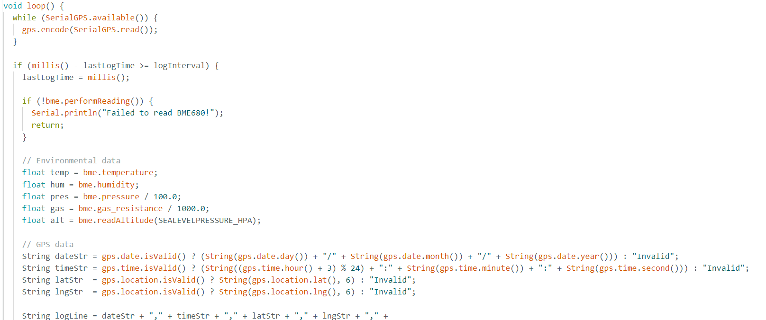
Example Code
Notes:
Inside loop(), the code:
Reads GPS data as it arrives.
Once the location is updated and the sensor is ready, it takes a reading: temperature, humidity, pressure, and gas resistance.
It also fetches the current latitude and longitude from GPS.
Then it logs all these readings into data.txt on the SD card.

Slide 9
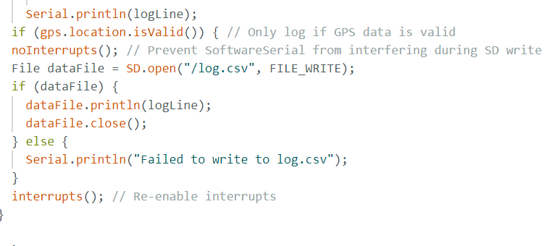
Example Code

Slide 10








Hands On
Your mission:
Follow this presentation and the handbook
(https://docs.google.com/document/d/19S4BqSk_Rdi75qzwWkpkeVnbttc9otIEB-O9kfYv9Ww/edit?usp=sharing) as your guide.
Reminder: Make sure to install the required sensor libraries if this is your first time setting up the project.

Slide 11

THANK'S FOR
YOUR ATTENTION

