Slide 1





Data is collected autonomously, without real-time communication.
Saving Data Offline (microSD Module)
Notes:
Welcome! Today we’ll explore how to log data to a microSD card, enabling offline data collection.
This is extremely useful when your project runs in a remote location without internet or constant supervision.
Instead of sending data over Wi-Fi, we’ll write it to a file on a microSD card that can be retrieved later.

Slide 2

CONTENT
01
Wiring the SD Module
02
Prepare the microSD Card
03
Install the Required Libraries
04
Example Code
Notes:
Here's what we’ll cover in four key steps:
Install the Required Libraries – enabling SD card support in the Arduino IDE.
Example Code – to demonstrate how data is saved to a file.
Wiring the SD Module – connecting the SD reader to your microcontroller.
Prepare the microSD Card – formatting and setting it up to store text logs.

Slide 3
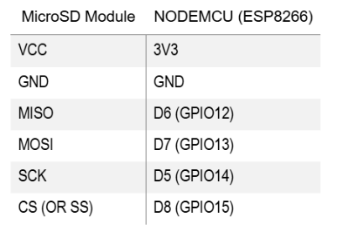
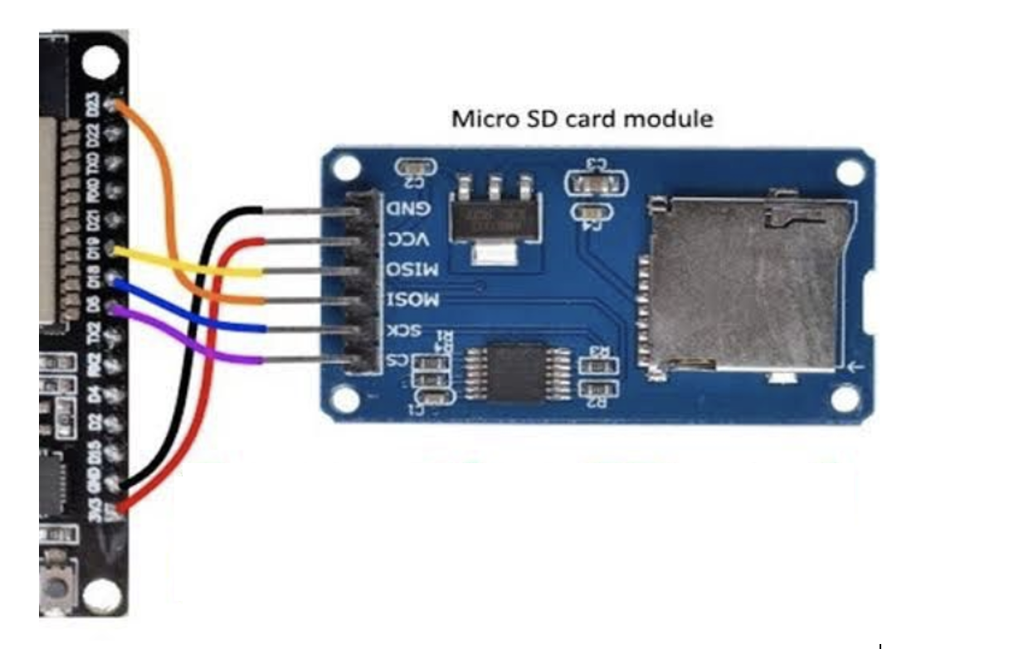



Wiring the SD Module
Notes:
This slide shows the wiring of a microSD card module to a microcontroller (e.g., ESP8266 or ESP32).
These modules use the SPI protocol for communication. Let me explain:
SPI (Serial Peripheral Interface) is a way for microcontrollers to talk to devices like SD cards using 4 main lines:
MOSI (Master Out Slave In)
MISO (Master In Slave Out)
SCK (Clock)
CS (Chip Select)
Typical pin connections:
MOSI → D7 (GPIO13), MISO → D6 (GPIO12), SCK → D5 (GPIO14), CS → D8 (GPIO15)
VCC → 3.3V or 5V (check your module!), GND → GND
Precise wiring is important. Incorrect connections may damage your SD card or cause communication failures.

Slide 4
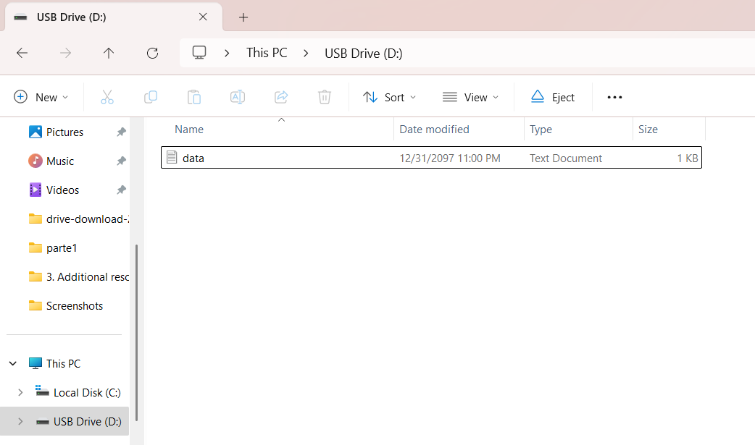
Prepare the microSD Card
Format the microSD card as FAT32 using your computer.
Create a text file named data.txt
Notes:
Before using the card, format it to FAT32 using your computer.
FAT32 is a file system — a way of organizing data — that microcontrollers can read reliably.
After formatting, create an empty file called data.txt on the card.
This is the file we’ll write to in our code. If it doesn’t exist, the module may fail to write.

Slide 5
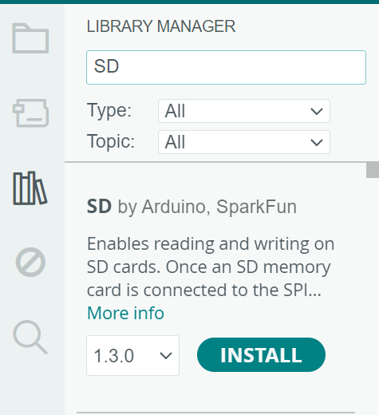
Install the Required Libraries
How to Install:
Open Arduino IDE.
Go to: Sketch > Include Library > Manage Libraries…
In the Library Manager, search for: SD and install the version by Arduino (not SDFat). This is the official SD library compatible with the ESP8266.
Notes:
Open the Arduino IDE and go to:
Sketch > Include Library > Manage Libraries…
Search for "SD" and install the one labeled by Arduino.
Don’t choose SDFat — that library is more complex and not guaranteed to work on ESP8266 by default.
This official SD library offers straightforward functions like SD.begin(), SD.open(), and file.println() that we’ll use.

Slide 6
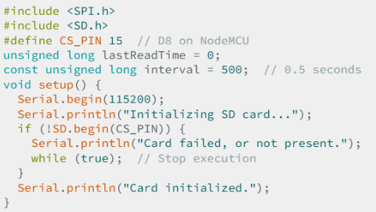
Example Code

Slide 7
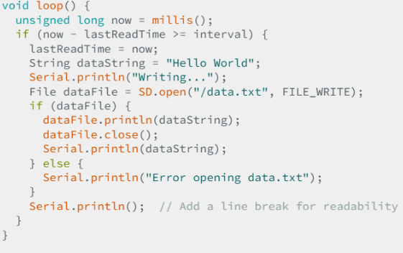
Example Code

Slide 8








THANK'S FOR
YOUR ATTENTION
Notes:
You now know how to log data locally using a microSD module — no internet required.
This is ideal for projects like remote weather stations, wildlife sensors, or offline loggers.
As a next step, try integrating sensor values instead of hardcoded text, and log time-stamped entries.

