Slide 1





Record where the data was taken.
Associating Data with Location (GPS Module)
Notes:
Welcome! In this session, we’ll learn how to integrate GPS data into your environmental or IoT projects.
The GPS module allows us to record the location where data was taken — critical for mapping, mobile sensing, and geolocation-based automation.
This is a foundational step if you're building applications like mobile air quality stations or geo-tagged logs.

Slide 2
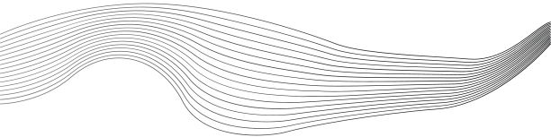
CONTENT
01
Wiring the GPS Module
02
Install the Required Libraries
03
Example Code
Notes:
Here’s what we’ll cover:
Install the Required Libraries — so we can communicate with the GPS module.
Example Code — to see how to initialize, read, and interpret GPS data.
Wiring the GPS Module — correct hardware setup to ensure communication.

Slide 3
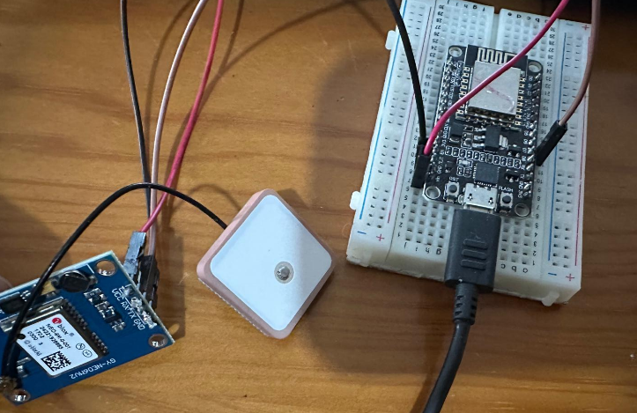
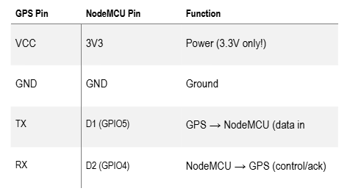



Wiring the GPS Module
Notes:
This note explains how to wire a GPS module (such as the NEO-6M) to a microcontroller, like an ESP8266 or ESP32, for communication.
Here's a breakdown:
1. Power Connections
VCC → 3.3V or 5V
This supplies power to the GPS module.
Some modules can take 5V, others need 3.3V—check the specific module’s requirements.
GND → Ground
Connect the GPS ground pin to the microcontroller’s ground to complete the electrical circuit.
2. Serial Communication Pins
TX (from GPS) → RX (on microcontroller)
GPS sends data from its TX (transmit) pin.
This should go to the RX (receive) pin on the microcontroller to receive that data.
RX (from GPS) → TX (on microcontroller)
If you need to send commands to the GPS (less common), connect the microcontroller's TX to the GPS RX.
Note: GPS modules often run at 3.3V logic, and connecting a 5V TX line directly can damage them—use a voltage divider or level shifter if needed.
3. SoftwareSerial Note
Many ESP boards (like ESP8266) have limited hardware UARTs (only one, usually).
To get around this, SoftwareSerial is used.
It allows you to emulate serial ports on other GPIO pins.
Example: You can assign D7 and D8 (GPIO13 and GPIO15) to act as RX/TX.
This lets you use the single hardware serial for debugging (via USB) and SoftwareSerial for GPS.
What is UART?
UART stands for Universal Asynchronous Receiver/Transmitter.
It's a hardware communication protocol used to send and receive serial data between devices (e.g., microcontroller ↔ GPS).
It uses two wires:
TX – Transmit (sends data)
RX – Receive (receives data)
What is SoftwareSerial?
SoftwareSerial is a software-based implementation of UART.
It allows you to use any two digital pins on a microcontroller to simulate a serial port.
Useful when:
Your microcontroller has only one hardware UART (e.g., ESP8266).
That UART is already being used (e.g., for USB debugging).

Slide 4
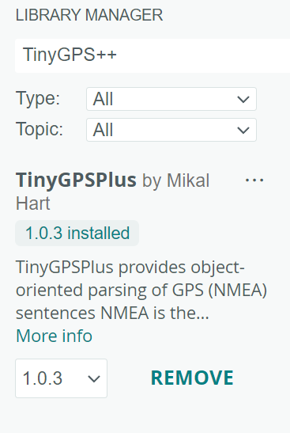
Install the Required Libraries
How to Install:
Open Arduino IDE.
Go to: Sketch > Include Library > Manage Libraries…
In the Library Manager, search for: TinyGPS++
Install the one by Mikal Hart
Notes:
Open the Arduino IDE and go to:
Sketch > Include Library > Manage Libraries…
Search for and install TinyGPS++ by Mikal Hart.
This library simplifies parsing GPS NMEA sentences into structured data like latitude, longitude, speed, altitude, and time.
It’s more efficient and user-friendly than parsing raw GPS output manually.

Slide 5
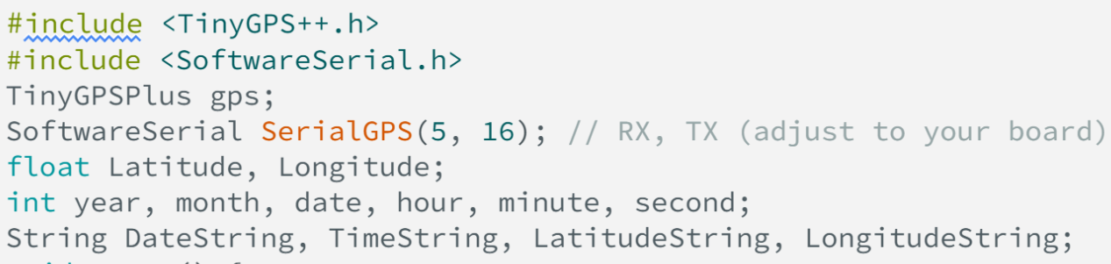
Example Code
Notes:
We import the required libraries and define pins for software serial communication.
TinyGPSPlus is the object that will parse data.
SoftwareSerial ss(...) creates a secondary serial channel for GPS communication.

Slide 6
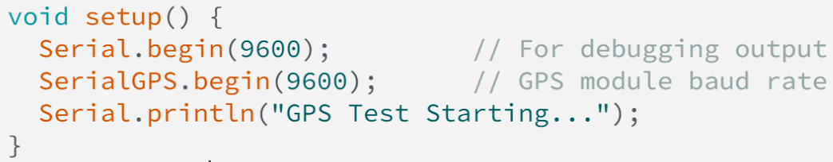
Example Code
Notes:
Sets up the serial monitor at 115200 baud to print data.
Initializes the GPS module communication at 9600 baud (standard for most GPS modules).

Slide 7
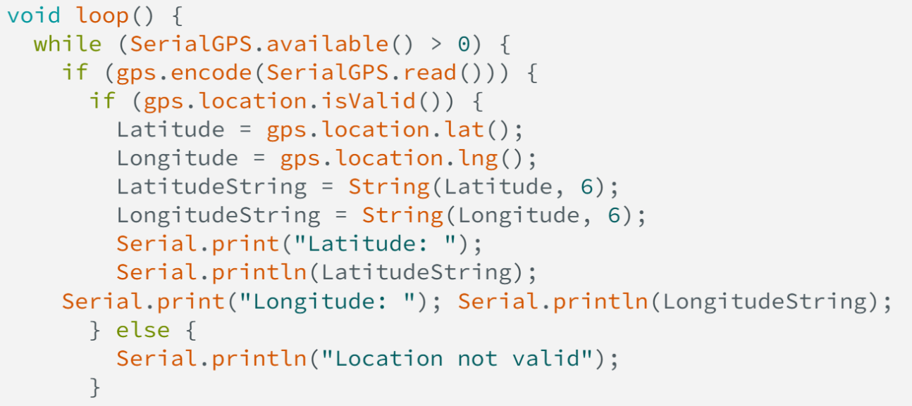
Example Code
Notes:
Continuously reads data from GPS and feeds it into the parser.
If a new location fix is available, prints the latitude and longitude with 6 decimal places of precision.
This level of precision is approximately ±10 cm — very useful for mapping!

Slide 8
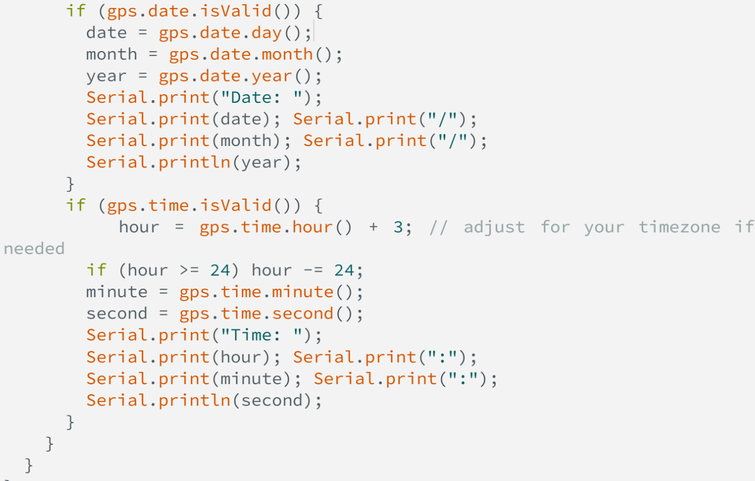
Example Code

Slide 9







THANK'S FOR
YOUR ATTENTION

