Slide 1





Capture real-world atmospheric data
Reading Environmental Data (BME680)
Notes:
Welcome! This presentation focuses on using the BME680 sensor to capture environmental data such as temperature, humidity, pressure, and gas levels.
This is a critical step toward creating smart devices that respond to real-world conditions.
The goal is to help you understand how to interface with the sensor and make sense of the data it provides.

Slide 2
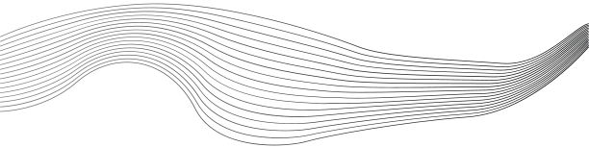
CONTENT
01
Wiring the BME680
02
Install the Required Libraries
03
Example Code
04
Analyze outputs
Notes:
Here's our roadmap:
Install Required Libraries – so the Arduino IDE can recognize and use the sensor.
Wiring the BME680 – to correctly connect the sensor to your microcontroller.
Example Code – to show how to start reading data from the sensor.
Analyze Outputs – to interpret the raw data and understand what it means.

Slide 3
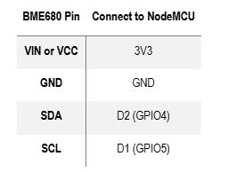
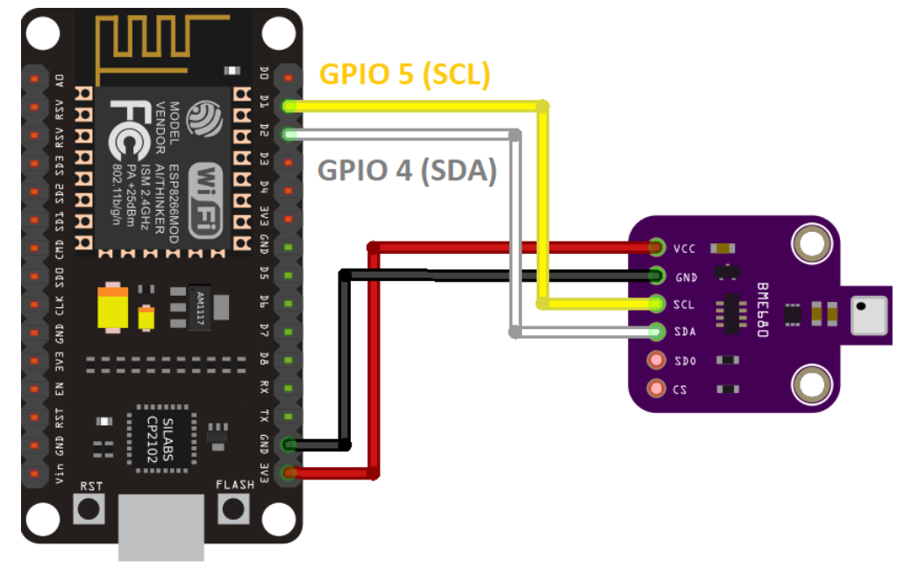



Wiring the BME680
Notes:
This diagram shows the correct wiring for the BME680 sensor to a NodeMCU.
Typical connections are:
VIN to 3.3V (or 5V depending on the sensor module)
GND to GND
SCL to D1 (or GPIO5)
SDA to D2 (or GPIO4)
Proper wiring is essential—incorrect connections may damage the sensor or cause failed communication.

Slide 4
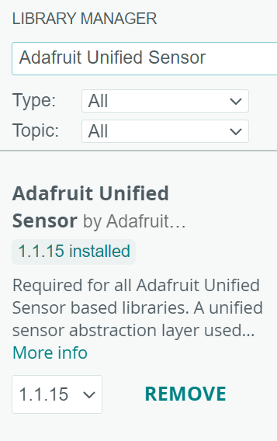
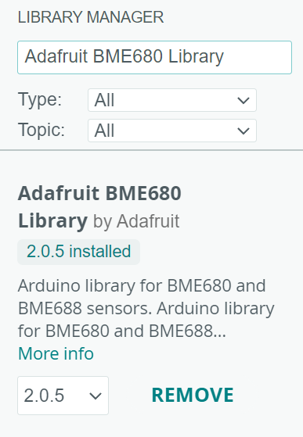
Install the Required Libraries
How to Install:
Open Arduino IDE
Go to Sketch > Include Library > Manage Libraries…
Search for and install:
Adafruit BME680 Library
Adafruit Unified Sensor
Notes:
Open Arduino IDE and navigate to Sketch > Include Library > Manage Libraries...
Install the following:
Adafruit BME680 Library – contains functions to communicate with the sensor.
Adafruit Unified Sensor Library – a dependency that standardizes sensor communication.
These libraries simplify code and ensure compatibility with the BME680.

Slide 5
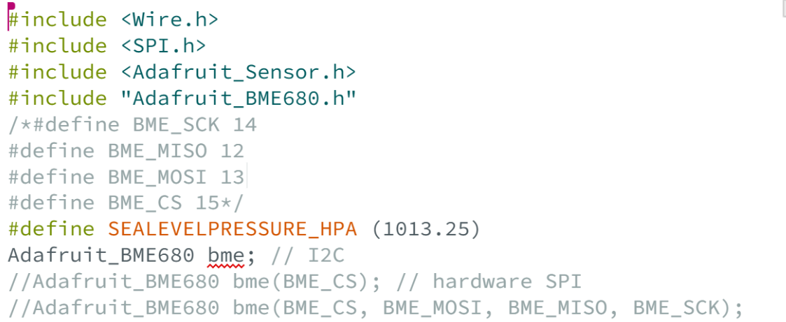
Example Code

Slide 6
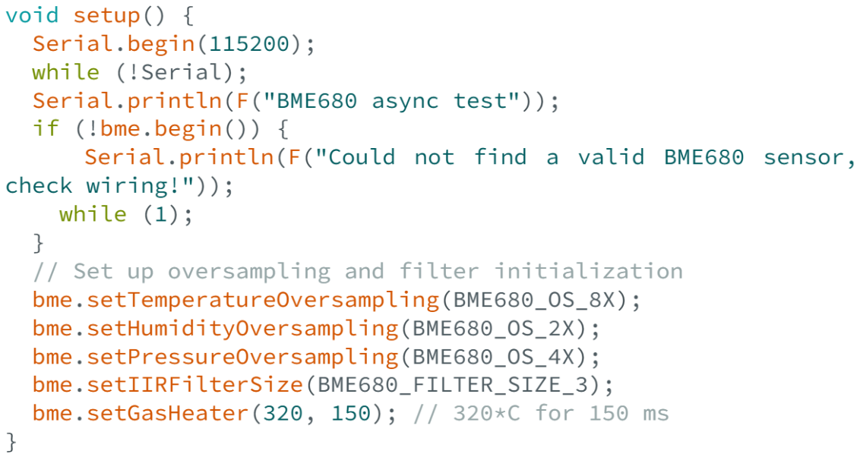
Example Code

Slide 7
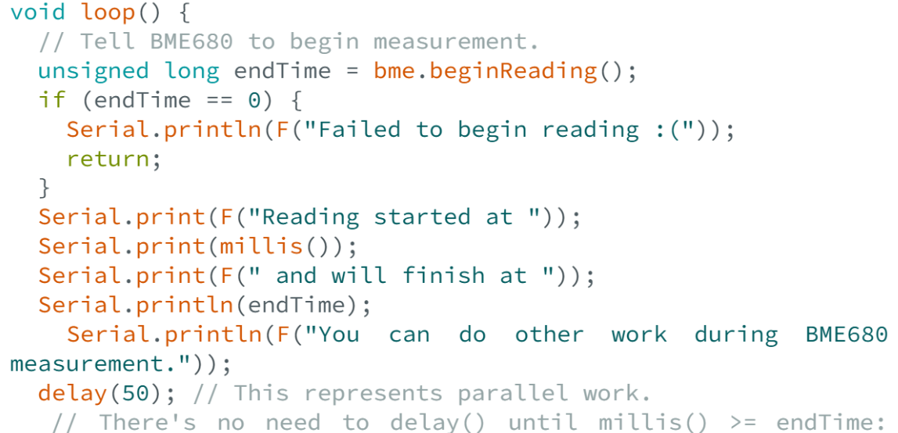
Example Code

Slide 8
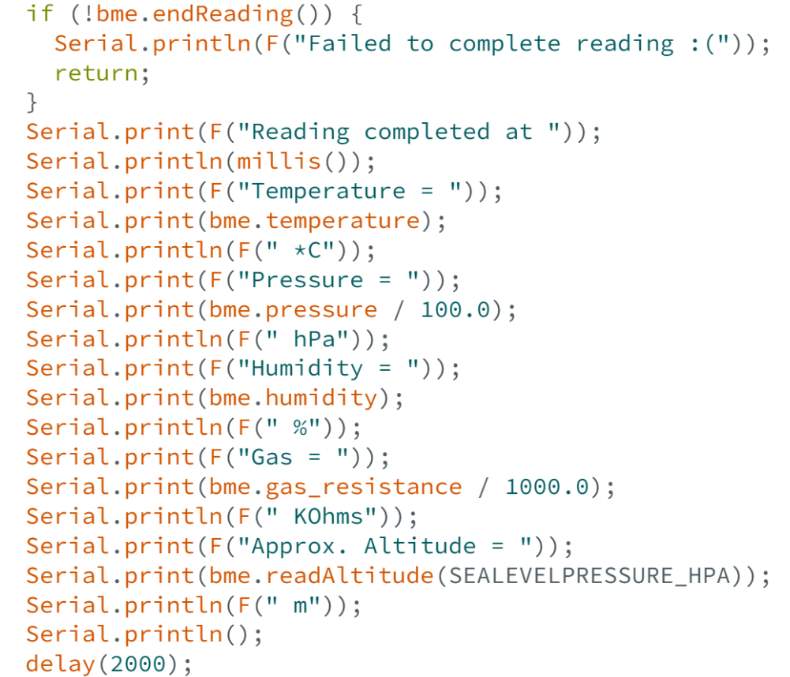
Example Code

Slide 9
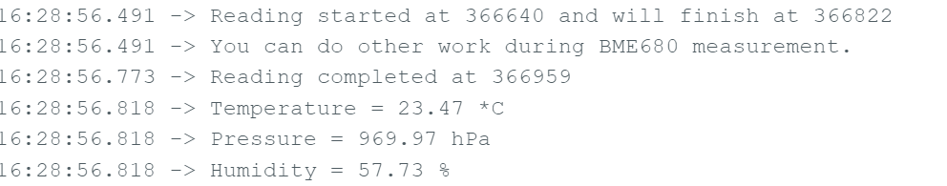
Analyze outputs

Slide 10
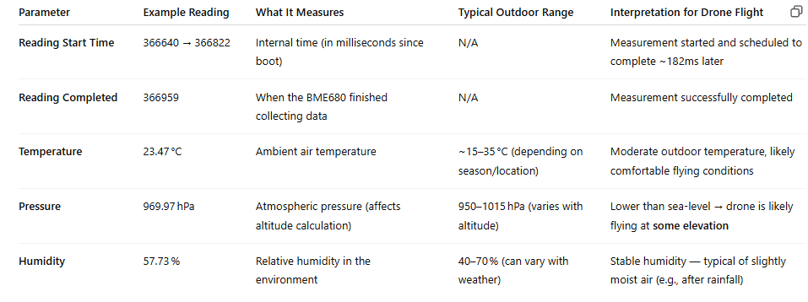
Analyze outputs

Slide 12







Hands On
Your mission:
Follow this presentation and the handbook (https://docs.google.com/document/d/1TaEKu4fmXjR0nPVU_rB5BKxXWu_I-oj9cHaotPzbTBc/edit?tab=t.0) as your guide, in the end of this task, modify the existing code so that your sensor takes a new reading every 5 seconds instead of the default timing.
-Explore the code and locate the section that controls timing between measurements.
-Tip: You're looking for something related to delay() or millis() comparison logic.
Can you make the sensor work on your own schedule?

Slide 13

THANK'S FOR
YOUR ATTENTION

