Slide 1





First proof of life
“Hello, World!” with ESP8266
Notes:
This is the "first proof of life" for your ESP8266 — a simple yet critical milestone.
Explicar o que é o hello world
Just like in any new embedded project, we want to verify that the board is functioning and we can communicate with it.
Uploading a "Hello, World!" sketch confirms that the development environment is correctly set up, the board is operational, and the USB connection works.

Slide 2
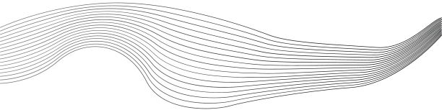
CONTENT
01
Install the Arduino IDE
02
Add the ESP8266 Board URL
03
Select the Correct Board
04
Configure Board Settings
05
Upload the "Hello, World!" Sketch
Notes:
These steps are essential because they form the complete setup pipeline from scratch to successful code upload.
Each step builds on the previous one — missing or misconfiguring any part can lead to frustrating errors.
By following them in order, we ensure a smooth experience getting started with ESP8266 development.

Slide 3
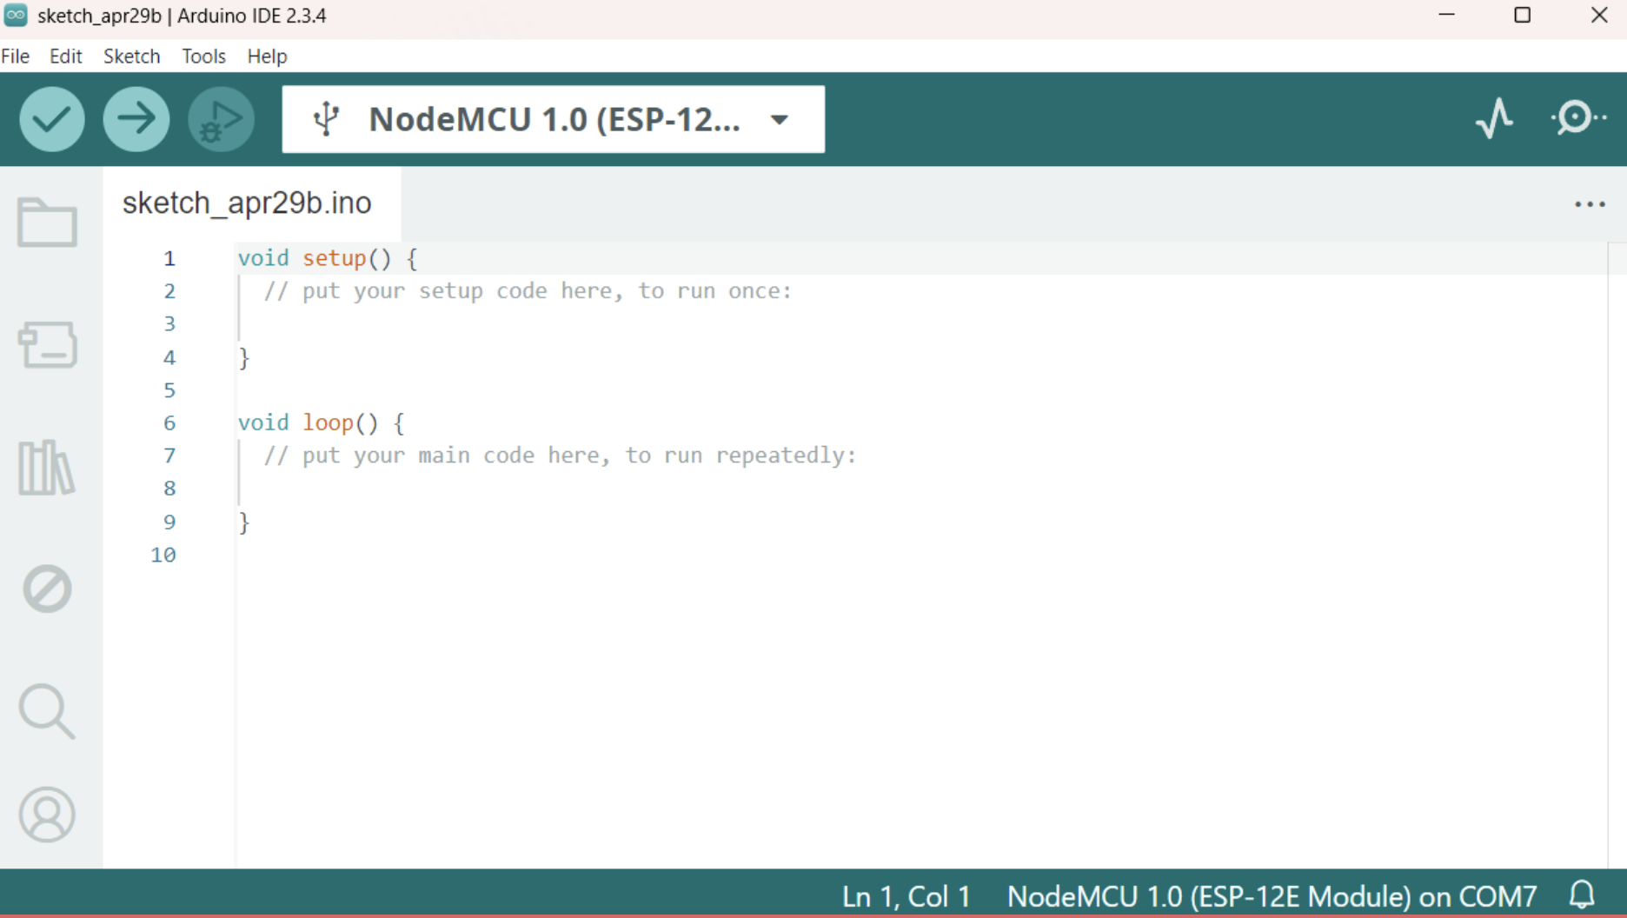



Install Arduino IDE
Go the following link and download Arduino IDE: https://docs.arduino.cc/software/ide/
Notes:
We are using the Arduino IDE because it is beginner-friendly, cross-platform, and has great community support.
Unlike other IDEs, Arduino simplifies the process of writing, compiling, and uploading code with minimal setup.
It also has built-in support for serial monitoring, libraries, and board management — which we’ll need throughout this process.

Slide 4
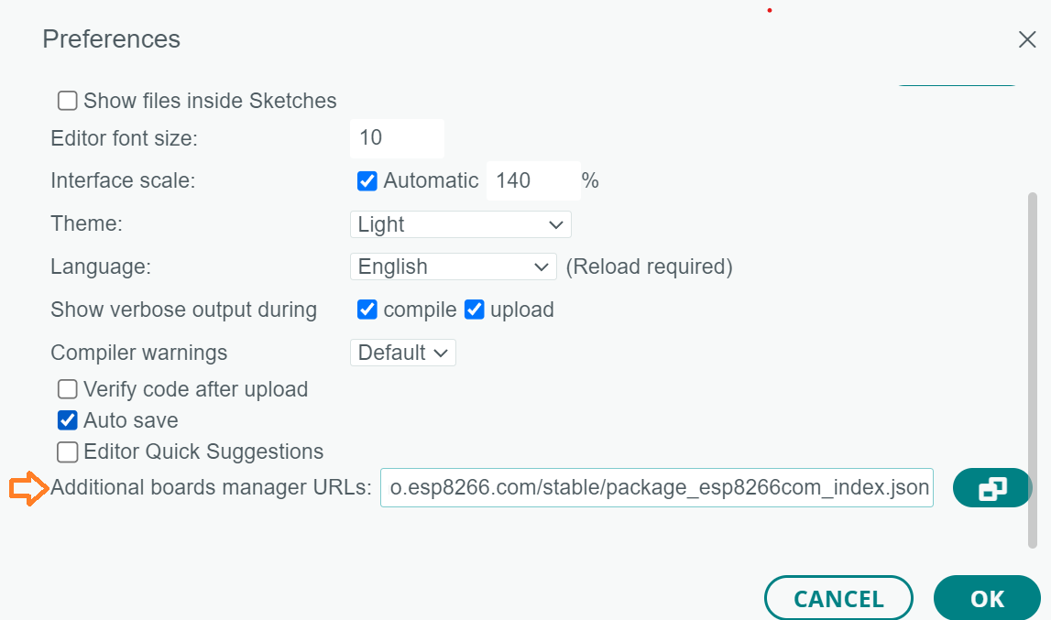
Add the ESP8266 Board URL
Go to File > Preferences.
Scroll down till you find the field "Additional Board Manager URLs", add this URL:
http://arduino.esp8266.com/stable/package_esp8266com_index.json
Notes:
The "Board Manager" is a tool in the Arduino IDE that allows you to install and manage support packages for different microcontroller boards.
By adding this URL, we are telling the IDE where to find the package that includes definitions, settings, and tools to work with ESP8266-based boards.
Without this step, the IDE won’t recognize your NodeMCU as a valid board.

Slide 5
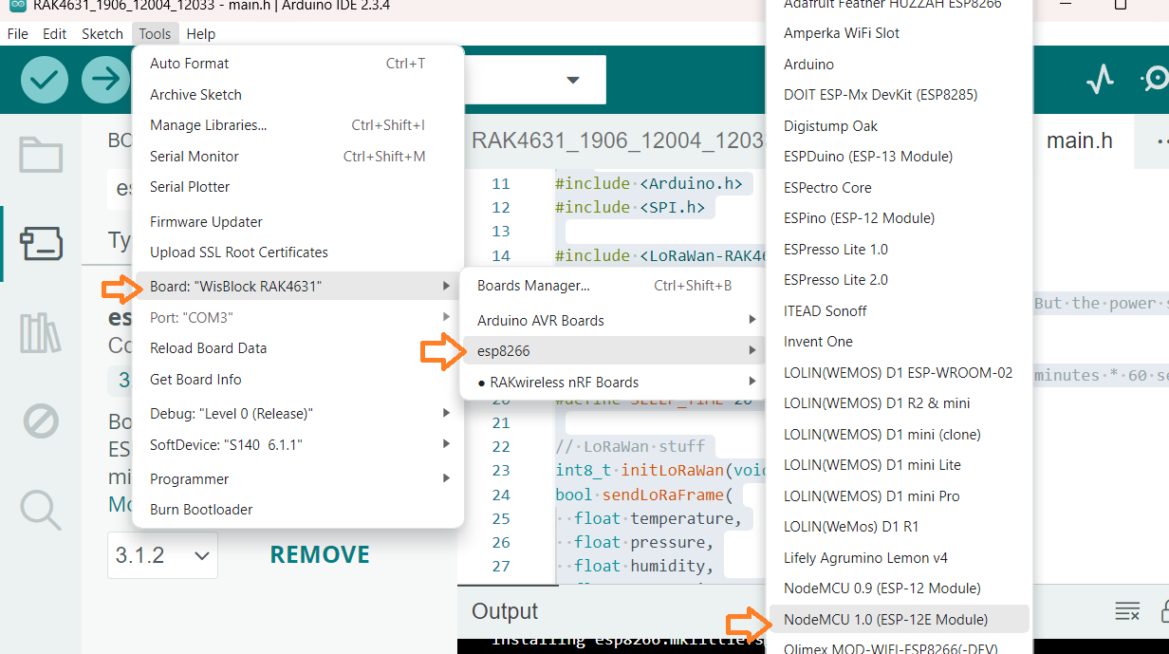
Select the Correct Board
Go to Tools > esp8266 > Board, and choose: NodeMCU 1.0 (ESP-12E Module)
Notes:
Selecting NodeMCU 1.0 (ESP-12E Module) ensures the IDE compiles the code for the correct hardware.
Different ESP8266 boards can have different pin mappings, flash sizes, or features.
This step ensures compatibility between our code and the board we are physically using.

Slide 6
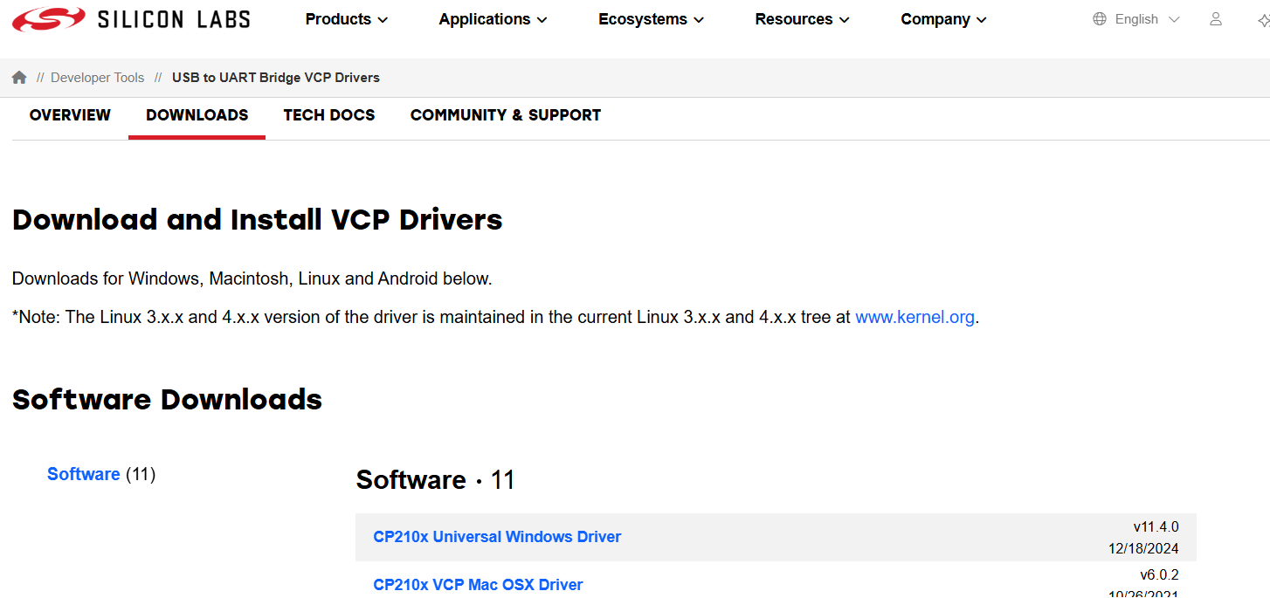
Configure Board Settings
Please refer to the handbook to do this step. You can find it in the following link: https://docs.google.com/document/d/1kQgIg533Jtssm3LG2PeQFb5hlb1OKwSLQl-dx8GvcHM/edit?usp=sharing
Notes:
You’ll refer to the handbook for installation steps, but here’s why this is crucial:
We are installing the CP210x USB-to-UART Bridge driver, which enables your computer to communicate with the ESP8266 over USB.
Without it, the computer won't recognize the board or assign it a COM port, which is necessary to upload any code.
It's a one-time setup, but absolutely essential.

Slide 7
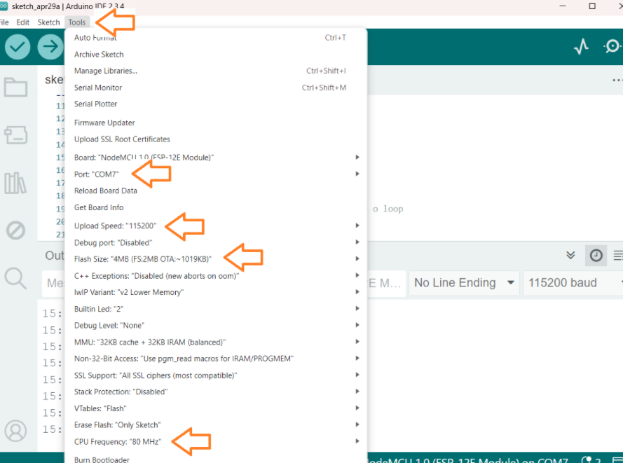
Board Settings
In the Tools menu, make sure these options are set:
Flash Size: 4MB (FS:2 MB OTA:~1019KB)
CPU Frequency: 80 MHz
Upload Speed: 115200
Port: select the port where your NodeMCU is connected
Notes:
These settings determine how your code is compiled and how it’s transferred to the board.
Flash Size (4MB FS:2MB OTA:~1019KB): Total memory for code and OTA updates; 2MB allocated for the filesystem and ~1MB for Over-the-Air updates.
CPU Frequency (80 MHz): Processing speed. 80 MHz is sufficient and more stable for beginners; higher speeds can cause instability.
Upload Speed (115200): The baud rate used to upload code. 115200 is fast and reliable.
Port: This must match the COM port assigned to your device in Device Manager. It’s how your IDE knows which device to upload to.

Slide 8
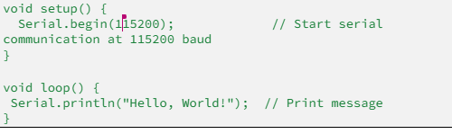
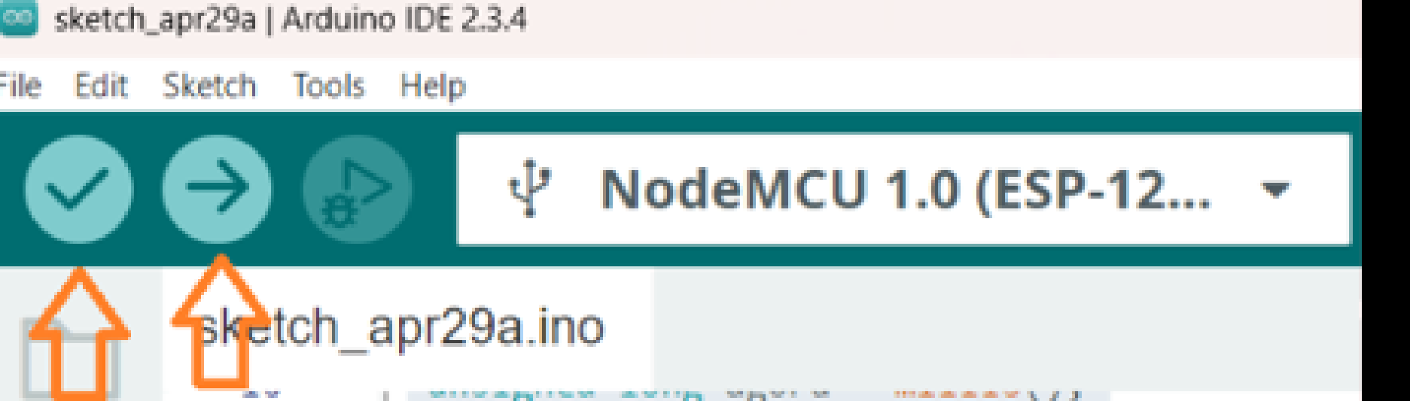
Upload the "Hello, World!" Sketch

Slide 9
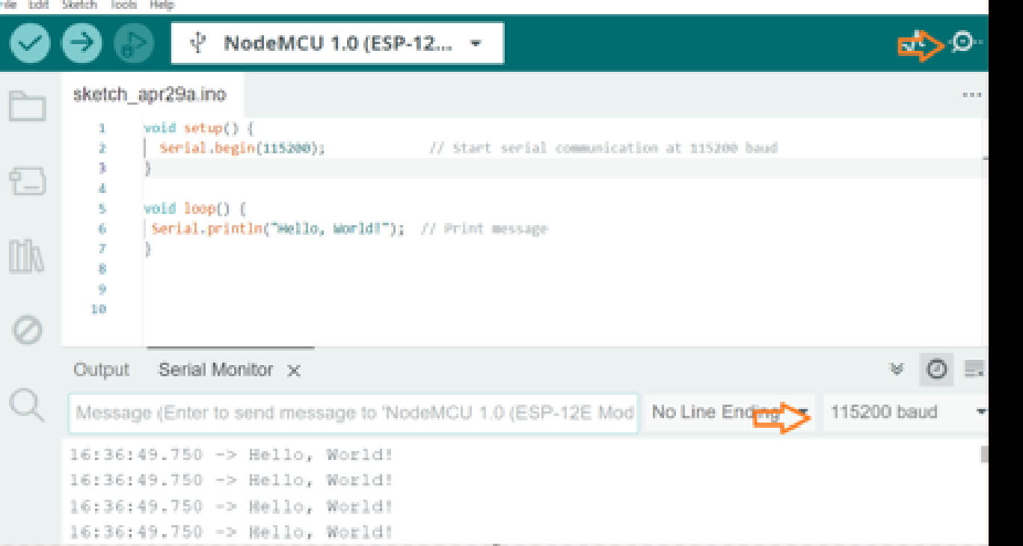
Upload the "Hello, World!" Sketch

Slide 10







Hands On
Your mission:
Follow this presentation and the handbook (https://docs.google.com/document/d/1kQgIg533Jtssm3LG2PeQFb5hlb1OKwSLQl-dx8GvcHM/edit?usp=sharing) as your guide.
Can you configure and run the “Hello World” ? If you have any doubt or issue during this process, please, feel free to ask !!

Slide 11

THANK'S FOR
YOUR ATTENTION

